Slide 1
Baseline algorithm

Slide 2
Basic strategy[1]
Enumeration + testing
Using two theorem to prune
[1]Chi Y, Xia Y, Yang Y, et al. Mining closed and maximal frequent subtrees from databases of labeled rooted trees[J]. IEEE Transactions on Knowledge and Data Engineering, 2005, 17(2): 190-202.

Slide 3
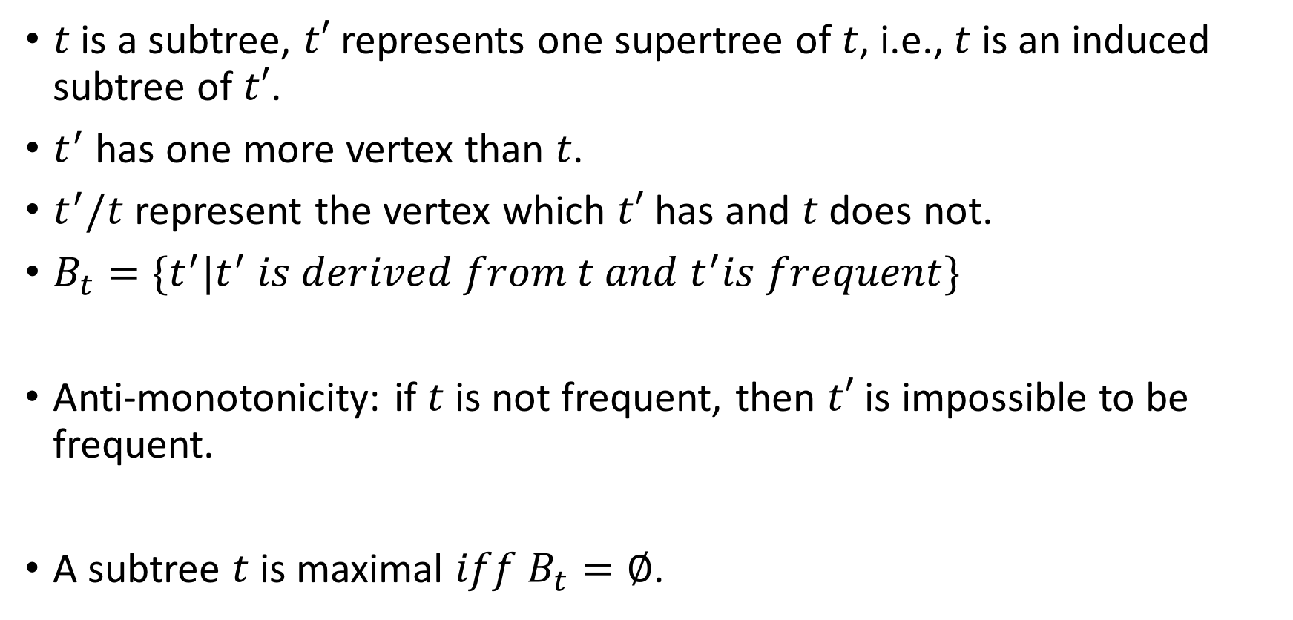
Definition
$t$ is a subtree, $t′$ represents one supertree of $t$, i.e., $t$ is an induced subtree of $t′$.
$t^{′}$ has one more vertex than $t$.
$t^{′}/t$ represent the vertex which $t′$ has and $t$ does not.
$B_{t}=\{t^{′}|t^{′} is derived from t and t^{′}is frequent\}$
Anti-monotonicity: if $t$ is not frequent, then $t′$ is impossible to be frequent.
A subtree $t$ is maximal $iff$ $B_{t}=∅$.

Slide 4
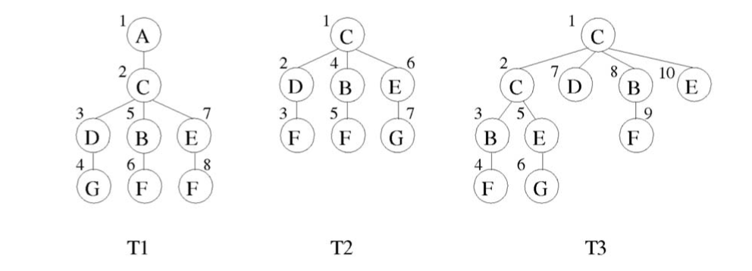

Occurrence-Matching
For $t^{′}∈B_{t}$ , $t^{′}$ and $t$ are occurrence matched if, for each occurrence of $t$ in database, there is an corresponding occurrence of $t′$.
Eg. {C-B-F} and {C-B} is occurrence matched.

Slide 5
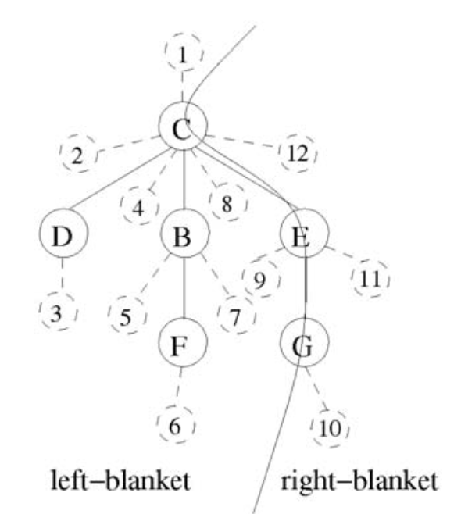
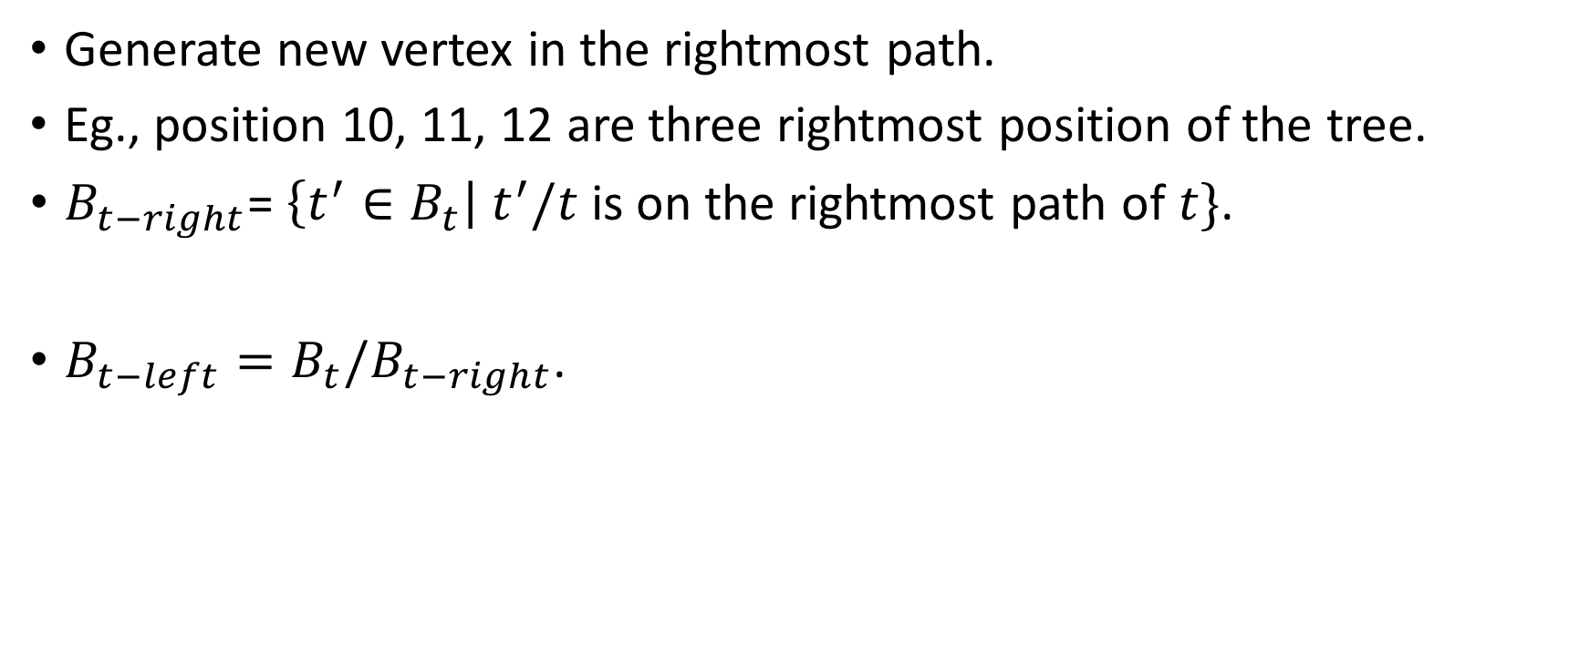
Enumeration rule
Generate new vertex in the rightmost path.
Eg., position 10, 11, 12 are three rightmost position of the tree.
$B_{t−right}$= $\left\{t^{′}∈B_{t}\right|{ t}^{′}/t$ is on the rightmost path of $t\}$.
$B_{t−left}=B_{t}/B_{t−right}$.

Slide 6
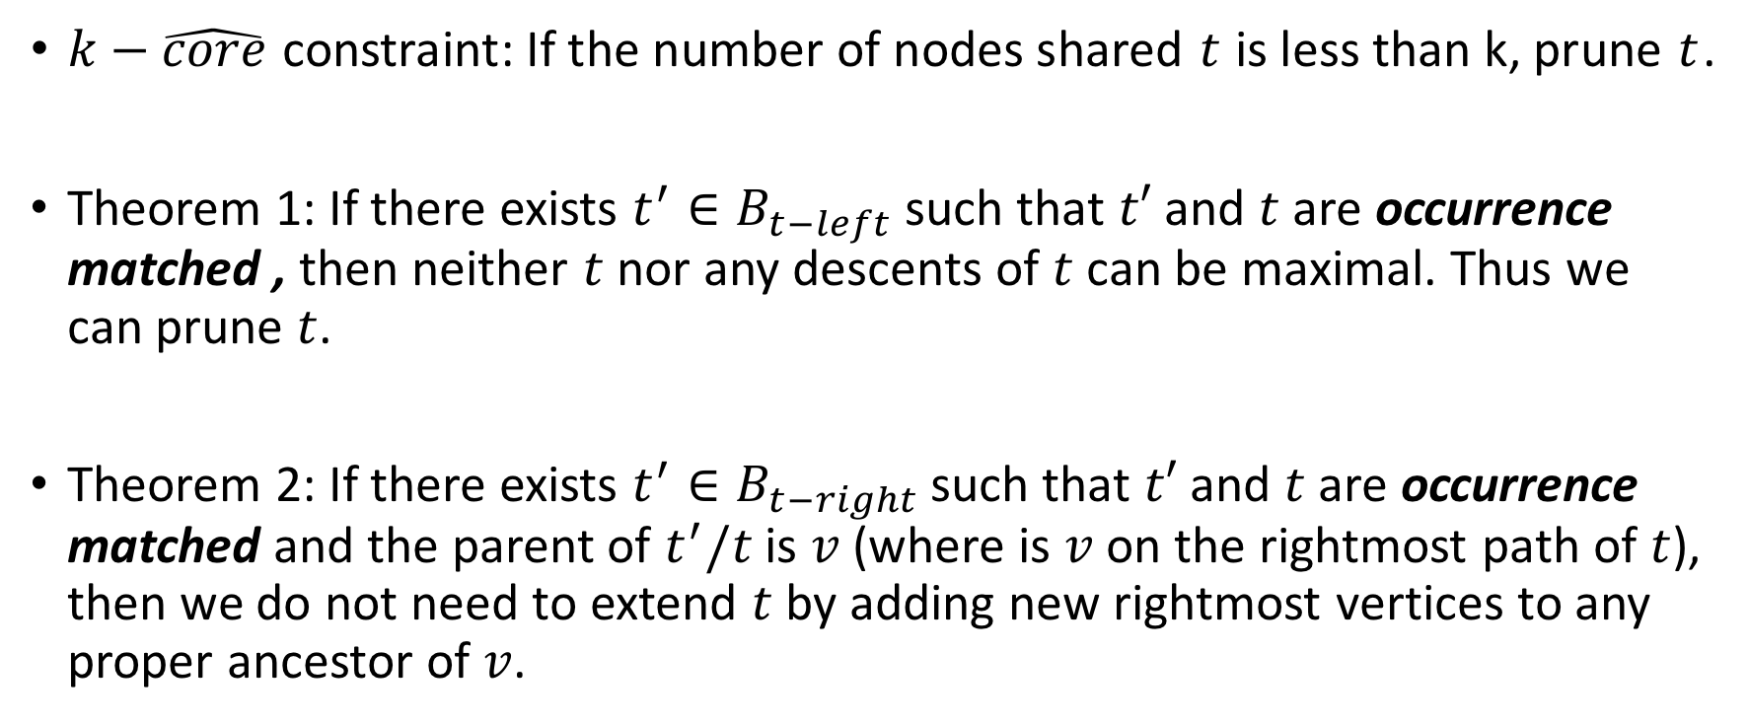
Pruning strategy
$k−\hat{core}$ constraint: If the number of nodes shared $t$ is less than k, prune $t$.
Theorem 1: If there exists $t^{′}∈B_{t−left}$ such that $t′$ and $t$ are occurrence matched , then neither $t$ nor any descents of $t$ can be maximal. Thus we can prune $t$.
Theorem 2: If there exists $t^{′}∈B_{t−right}$ such that $t′$ and $t$ are occurrence matched and the parent of $t^{′}/t$ is $v$ (where is $v$ on the rightmost path of $t$), then we do not need to extend $t$ by adding new rightmost vertices to any proper ancestor of $v$.

Slide 7
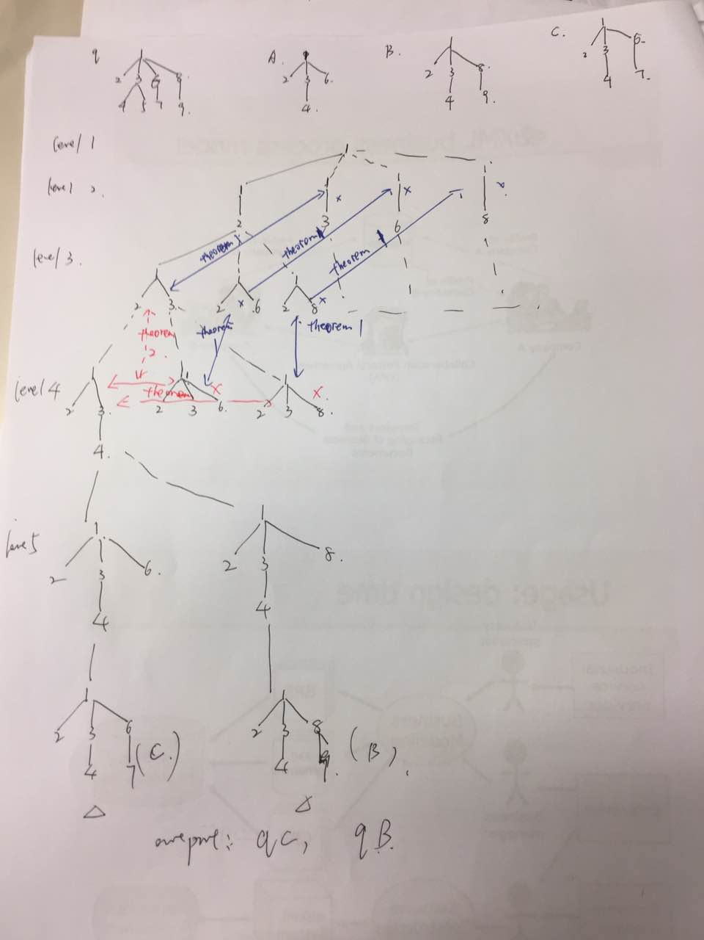
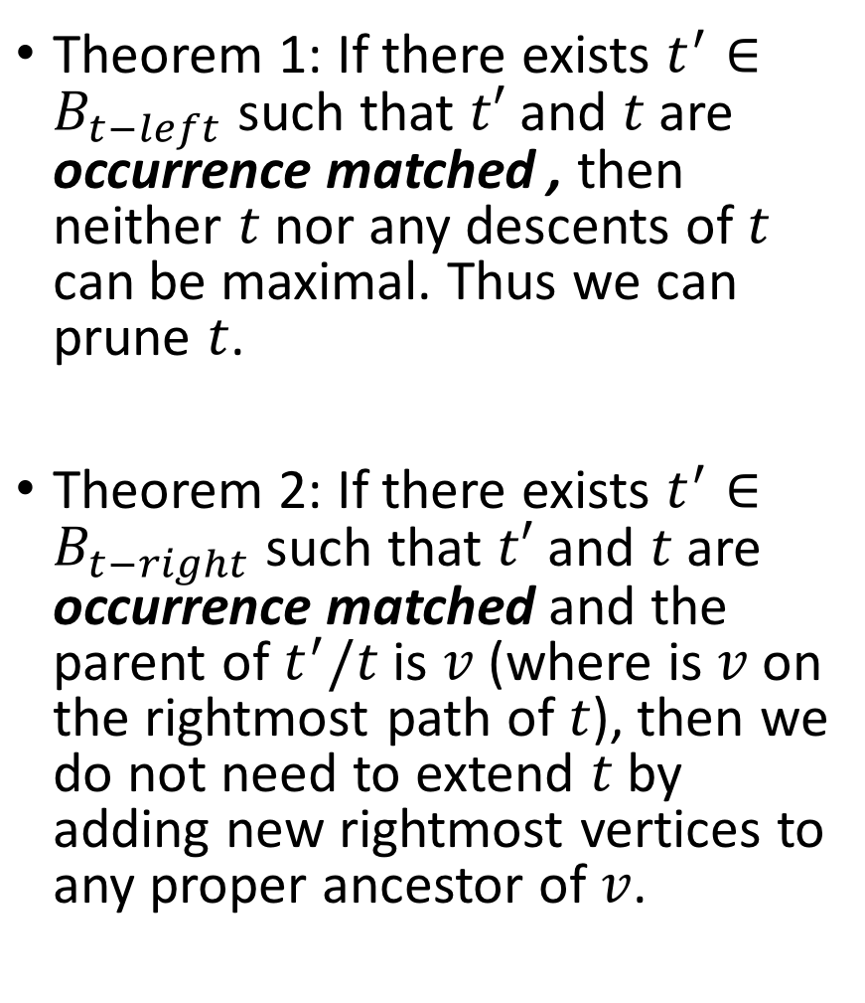
Theorem 1: If there exists $t^{′}∈B_{t−left}$ such that $t′$ and $t$ are occurrence matched , then neither $t$ nor any descents of $t$ can be maximal. Thus we can prune $t$.
Theorem 2: If there exists $t^{′}∈B_{t−right}$ such that $t′$ and $t$ are occurrence matched and the parent of $t^{′}/t$ is $v$ (where is $v$ on the rightmost path of $t$), then we do not need to extend $t$ by adding new rightmost vertices to any proper ancestor of $v$.

